Slide 1
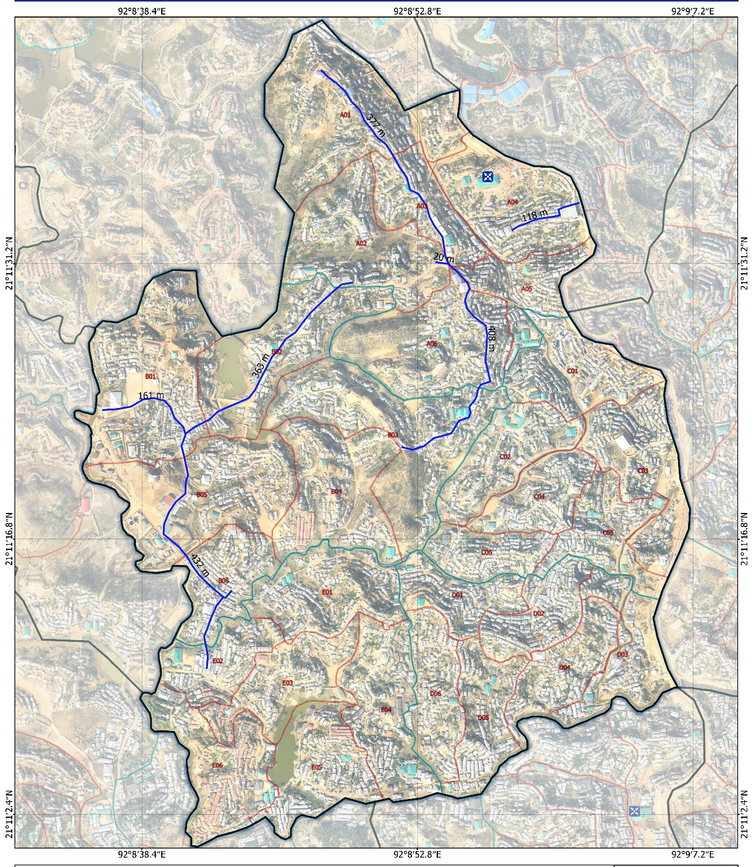

CiC OFFICE
SUB-PROPOSED DRAIN CONSTRUCTION BY BDRCS/GERMAN RED CROSS
CAMP BOUNDARY
BLOCK BOUNDARY
SUB-BLOCK BOUNDARY
NOTE: ORIGINAL CONTENT OF THE MAP IS TAKEN FROM IOM AS PER THE DETAIL PROVIDED IN THE SHEET
CHECKED BY – KHAIRUL BASHAR- WASH MANAGER PMO
NOTED BY – SANJAY MUKHERJEE- PC– GERMAN RED CROSS
DATE-03032020
DRAWING NO- UC18DN1
MAP OF THE PROPOSED LOCATION BY SMSD
GENERAL ALIGNMENT DRAWING – PROPOSED 4 KM DRAINAGE AT CAMP-18 UKHIA

Slide 2
GENERAL SPECIFICATION
All Brick Work shall be first class.
All plain cement concrete shall be of ratio 1:2:4
All Cement Plater work Shall be of ratio 1:4
Excavation Work shall be compacted to desired level as directed site engineers in-charge
PCC Bed shall be laid On plastic apron of standard quality approved by site engineer.
In some places have to construct 255mm (10”) thick brick work based on alignment as per the direction of Engineer in-charge.
130 mm Brick work with plaster
130 mm Brick work with plaster
305 mm
Brick work
(Average Hight)- to be adjusted as per site topo
305 mm
Wide Drain
A
A’
DRAWN BY – ZAHIRUL ISLAM- SPO – ENGINEER- GERMAN RED CROSS
CHECKED BY – KHAIRUL BASHAR- WASH MANAGER PMO
NOTED BY – SANJAY MUKHERJEE- PC– GERMAN RED CROSS
DATE-03032020
DRAWING NO- UC18DN2
100 mm PCC Bed
305 mm
Wide Drain
Plastic Sheet Apron for protecting PCC seepage during construction
565 mm
565 mm
Compact Soil Foundation
PART PLAN OF PROPOSED SURFACE DRAIN
PART SECTION A-A’ OF PROPOSED SURFACE DRAIN
GENERAL ARRANGEMENT DRAWING – PROPOSED 4 KM DRAINAGE AT CAMP-18, UKHIA

